Slide 1
Housing Units WA
Seojun Kim
(WAOFM - April 1 - Housing Units by State, County and City, 1990 to Present)

Slide 2
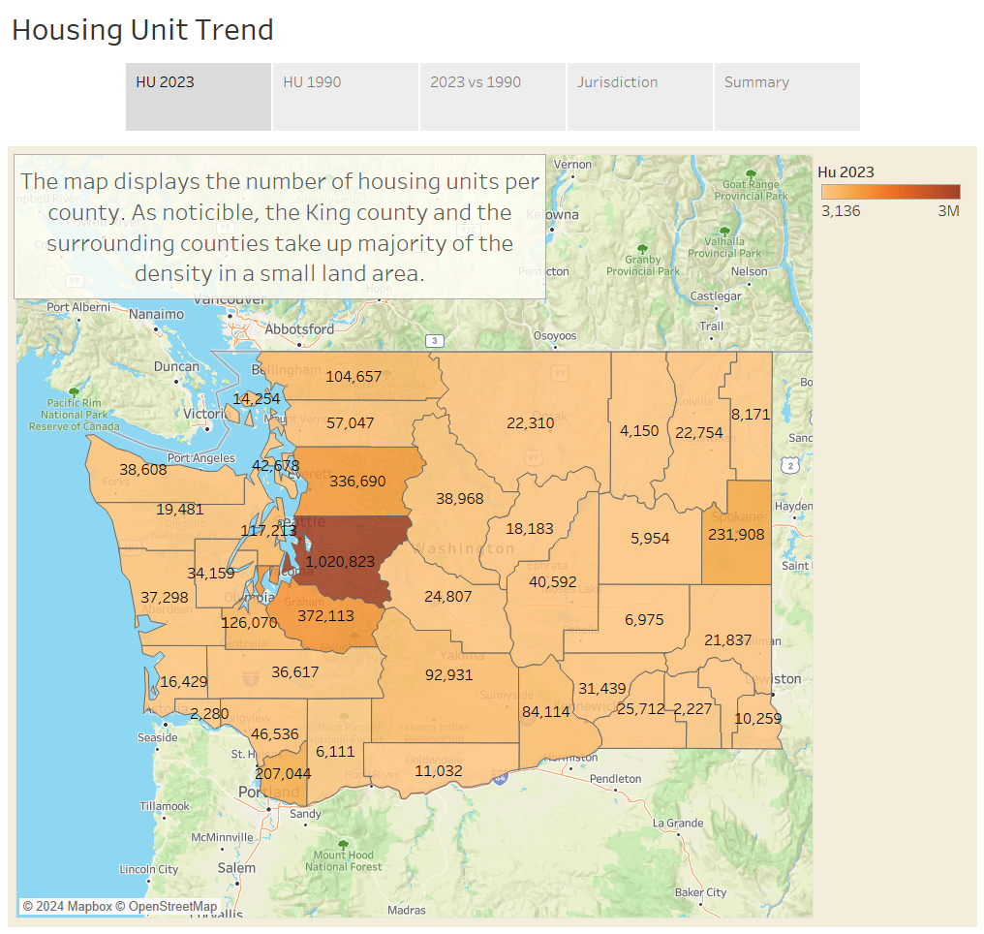

Slide 3
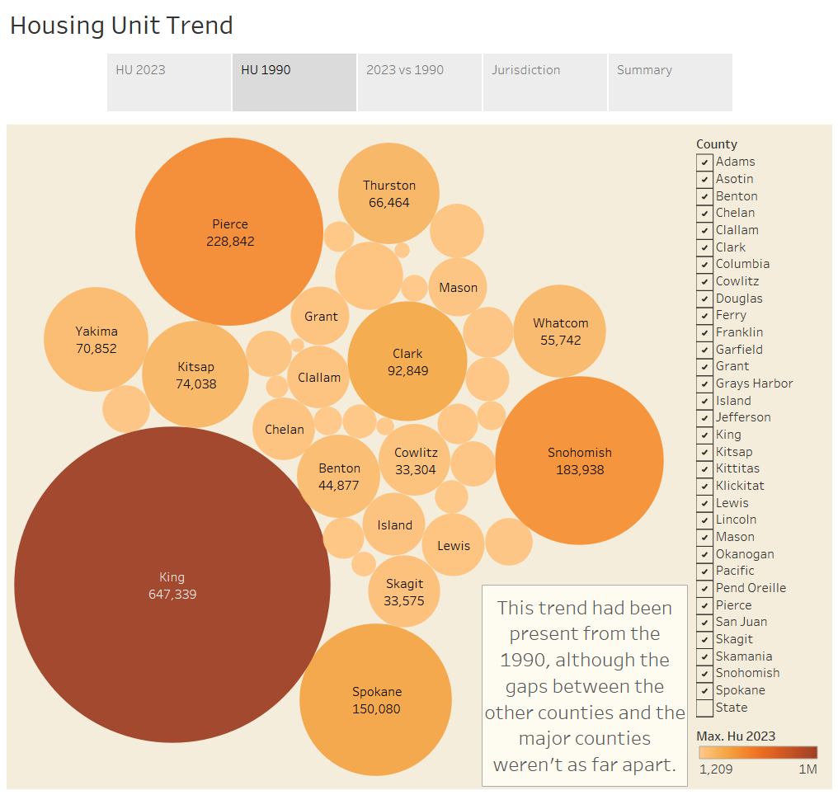

Slide 4
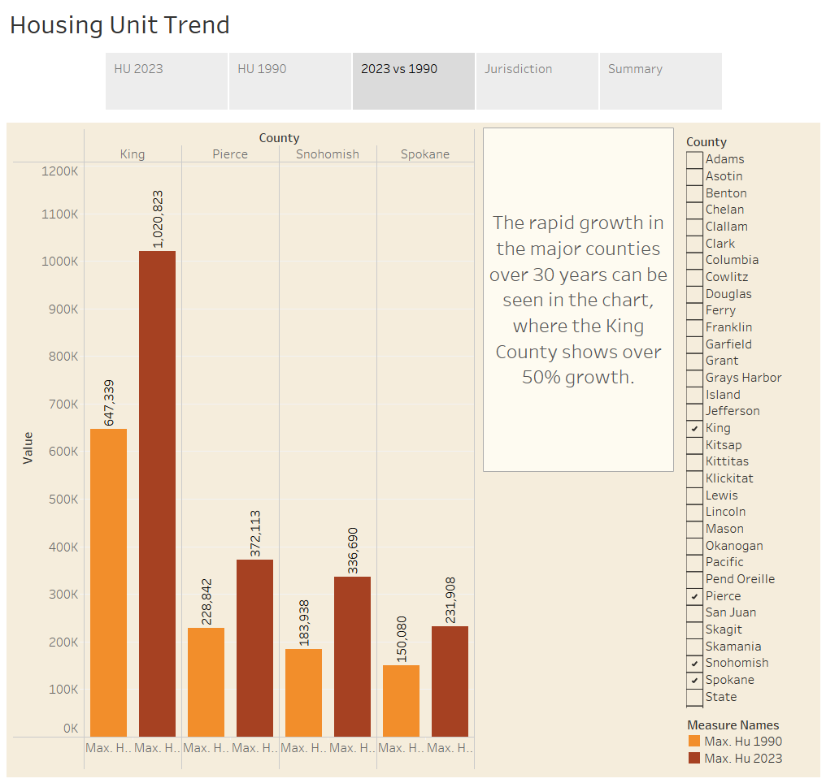

Slide 5
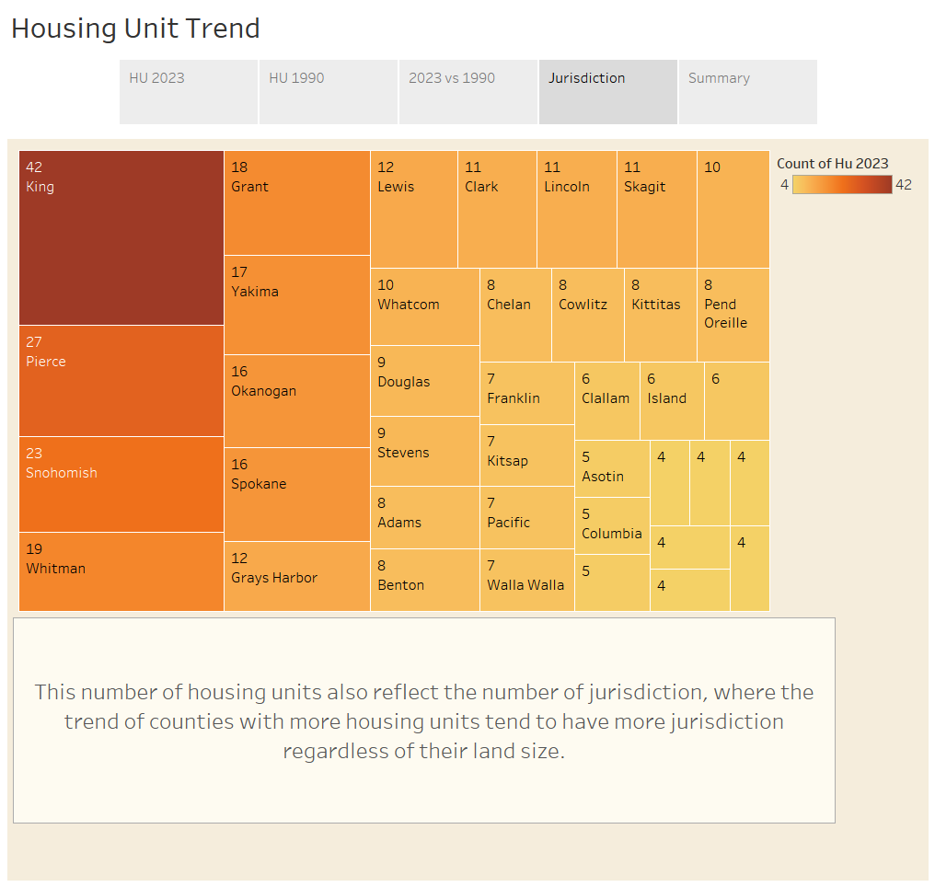

Slide 6
